Slide 1
Effective Health literacy Strategies to Help CHWs Successfully Engage Limited English Proficient (LEP) Patients
Presented
Belinda Gonzalez Hampton, MBA, CHW, CHWI (Texas)
Community Engagement Liaison, Texas Association of Charitable Clinics

Slide 2
Housekeeping
All attendees will be muted during the webinar
Ask questions using the Question & Answer (Q&A) feature
The webinar will be recorded and posted in the Health Literacy Solutions Center webinar archives
Following the webinar, you will receive an email containing a link to a brief online evaluation. If you are requesting continuing education (CE) credits, you must submit an evaluation in order to receive your CE certificate.

Slide 3
Today’s Objectives Will be to share:
Define Health Literacy and LEP
Communication strategies for working with LEP populations successfully and the definition of Limited English-Speaking Proficiency (LEP) and its importance to health care professionals.
The Importance of Combining Health Literacy with Communication techniques to obtain optimal success with patient/clinic/ health outcomes
Effective and Useful Resources for CHWs work with LEP populations

Slide 4
All to Add to the CHW Toolkit

Slide 5
In the CHW Toolkit there are many tools.
The Two Main Tools are:
Knowledge and Experience

Slide 6
Health Literacy: New Definitions by the CDC
Personal health literacy is the degree to which individuals have the ability to find, understand, and use information and services to inform health-related decisions and actions for themselves and others.
Organizational health literacy is the degree to which organizations equitably enable individuals to find, understand, and use information and services to inform health-related decisions and actions for themselves and others.

Slide 7
Definition of LEP
The Federal definitions states that individuals who do not speak English as their primary language and who have a limited ability to read, speak, write, or understand English can be limited English proficient, or "LEP." These individuals may be entitled language assistance with respect to a particular type or service, benefit, or encounter.

Slide 8
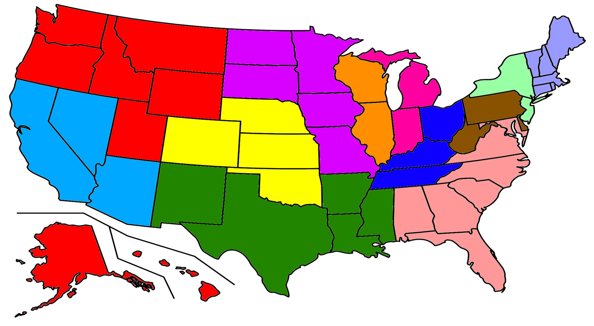
Largest LEP Populations in the U.S.

Slide 9
Common Challenges with LEP Populations and all others

Slide 10
Common Characteristics of LEP Populations
Low Income
No insurance or under-insured
Poor reading skills ( low literacy even in native language)
Hard-working in low-paying high risk jobs
Private
High rates of chronic disease
Social networks are close-knit ( church, neighbors, family)
Emergency room is closes medical alternative

Slide 11
Common Referral Sources for CHW’s
Charitable Clinics
County hospitals
Neighborhood clinics
Schools
Community Centers
Church health clinics
Homeless shelters
Refugee or re-settlement centers
Private doctors/medical centers (rare)
Other health providers (public health, immunization events, etc. )

Slide 12
Community Health Worker!

Slide 13
Common Services from CHW’s
Language translations
Medication explanation
Transportation
All other needs

Slide 14
Where does Health Literacy begin with LEP?
Health literacy is whatever it takes to communicate effectively with the patient about their health condition, needs, medication, resources, etc!

Slide 15
Communication must be: clear concise true easy to understand (simple, not dumb)

Slide 16
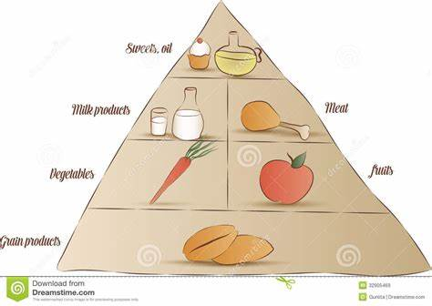
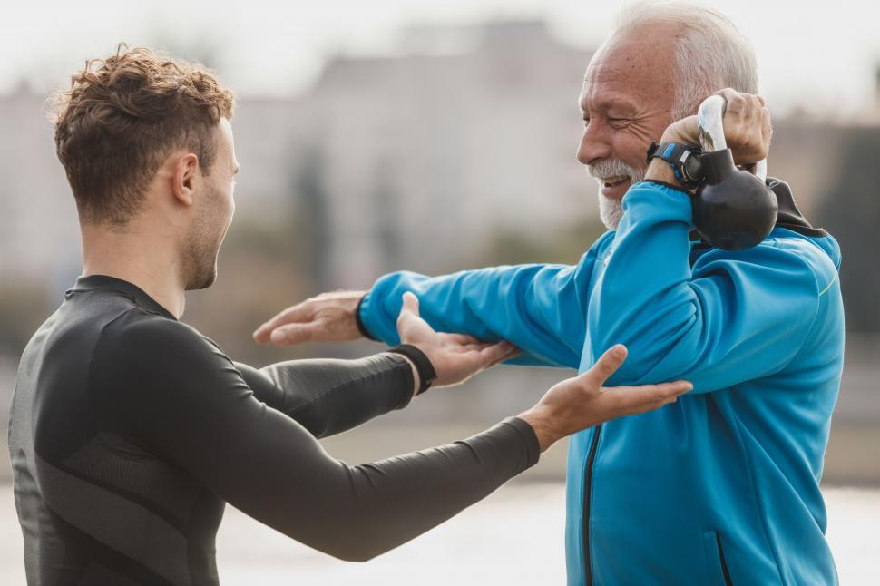
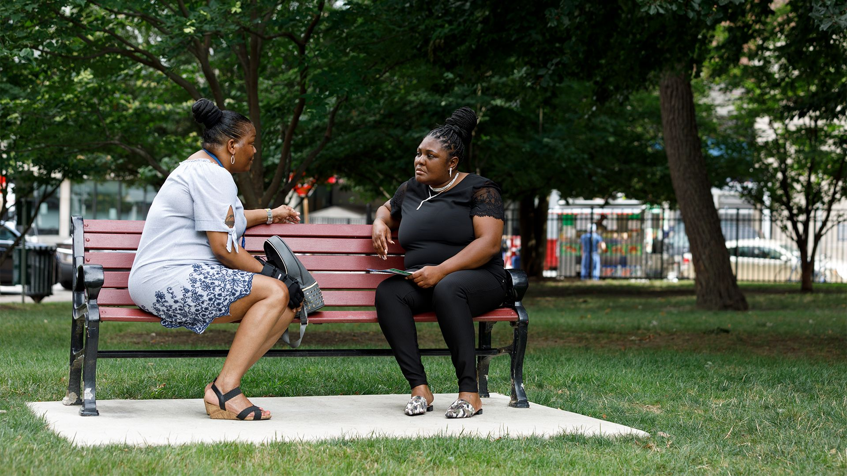
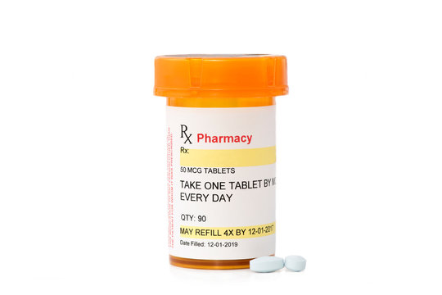
Health Literacy in ACTION

Slide 17
CHW Successful strategies with LEP populations
Culturally competent staffing that is community-based
Language interpreters, translators, and language lines
Effectively incorporating health literacy
Language Access Plan

Slide 18
Evaluation of our Strategies
Preparation ( know as much about your patient and family as you can)
Check your culture
Materials ( written, pictures,)
Resources
Teach-back
Follow-through
Evaluation together with patient ( after intervention or every few weeks)

Slide 19
Case Example ( need a volunteer)
Hortencia, is a 74 year-old Hispanic LEP female. She lives with her four grand-children, oldest is 15. She has high blood pressure but does not take her medicine regularly because it makes her feel bad. She does not tell the doctor this information. She has been missing doctor visits. The clinic sends the CHW out to visit. Hortencia has broken her arm, when she got dizzy and fell. What does a CHW do to help, and ensure help continues. There are both health literacy issues and LEP issues.

Slide 20
Success Measures for our Journey as CHW’s
Share Ideas
Have a Support group
Honor your purpose. Write a personal mission statement.
Teach others
Professional development
Stay current with all relevant information!

Slide 22
Sources
California Primary Care Association-Providing Health Care to Limited English Speaking (LEP) Patients
http://www.cpca.org/
Language Line Interpreting – Professional On-Demand Phone Interpreting
https://www.languageline.com/interpreting/phone
Limited English Proficiency (LEP) A Federal Interagency Website
https://www.lep.gov/
Migration Policy Institute
www.migrationpolicy.org
LEP Policy Guidance issued by different federal agencies:
http://www.lep.gov/guidance/guidance_index.html

Slide 23
Thank you for Attending
You will receive an email containing a link to a brief online evaluation. If you are requesting continuing education (CE) credits, you must submit an evaluation in order to receive your CE certificate.
Visit the Health Literacy Solutions Center at www.healthliteracysolutions.org to:
Access the recording and presentation materials of today’s webinar.
Register for upcoming webinars.

